Slide 1
UMS with Kubernetes & Cassandra
1705031 - 1705034 - 1705041
MOCK UI PRESENTATION

Slide 2

Students Page

Slide 3
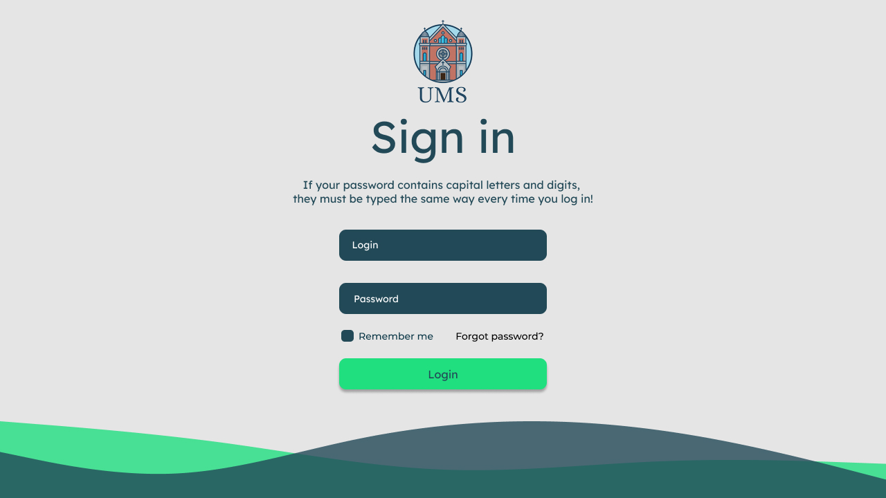

Slide 4
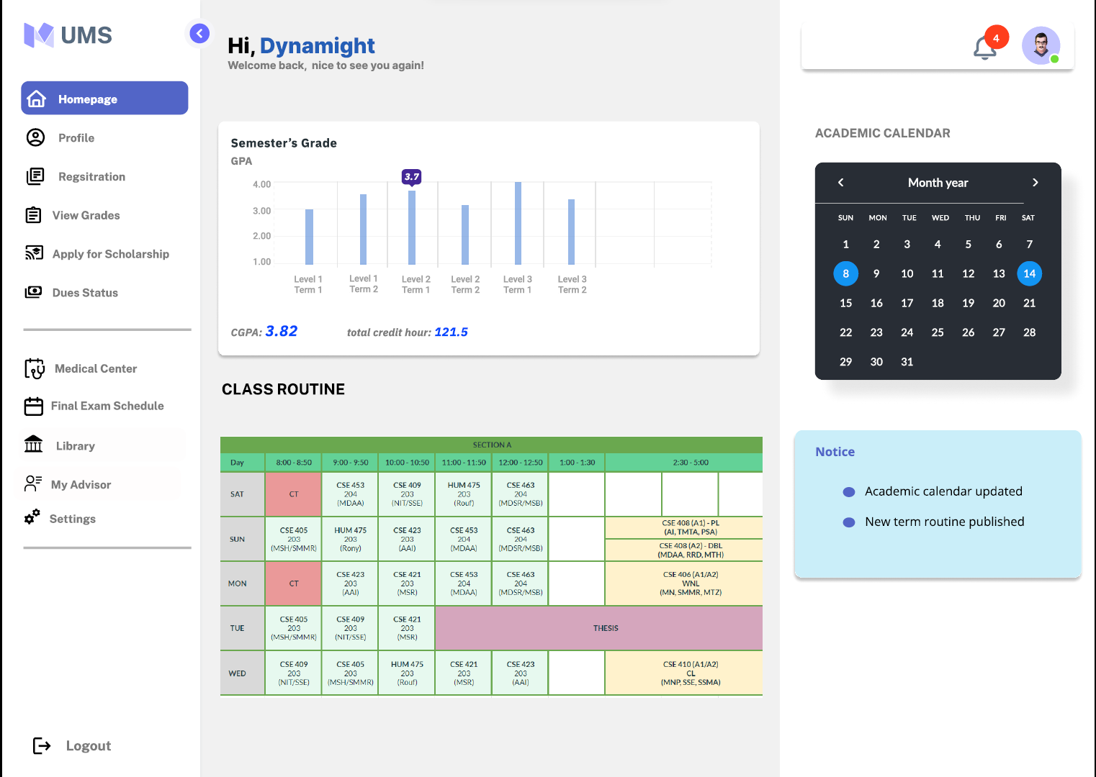
Homepage

Slide 5
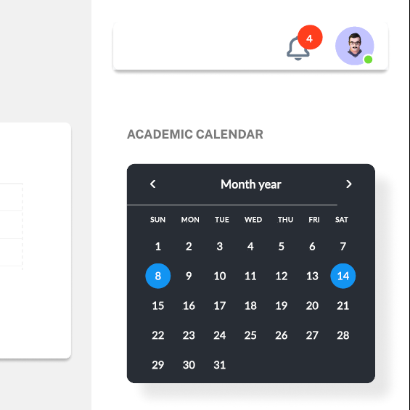
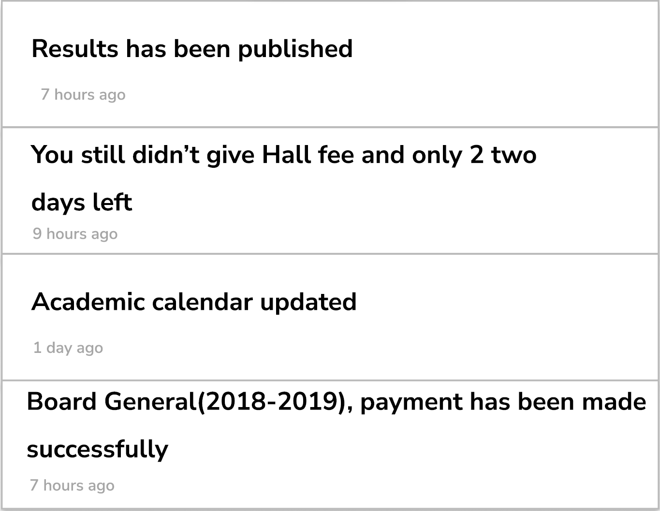
Notification

Slide 6
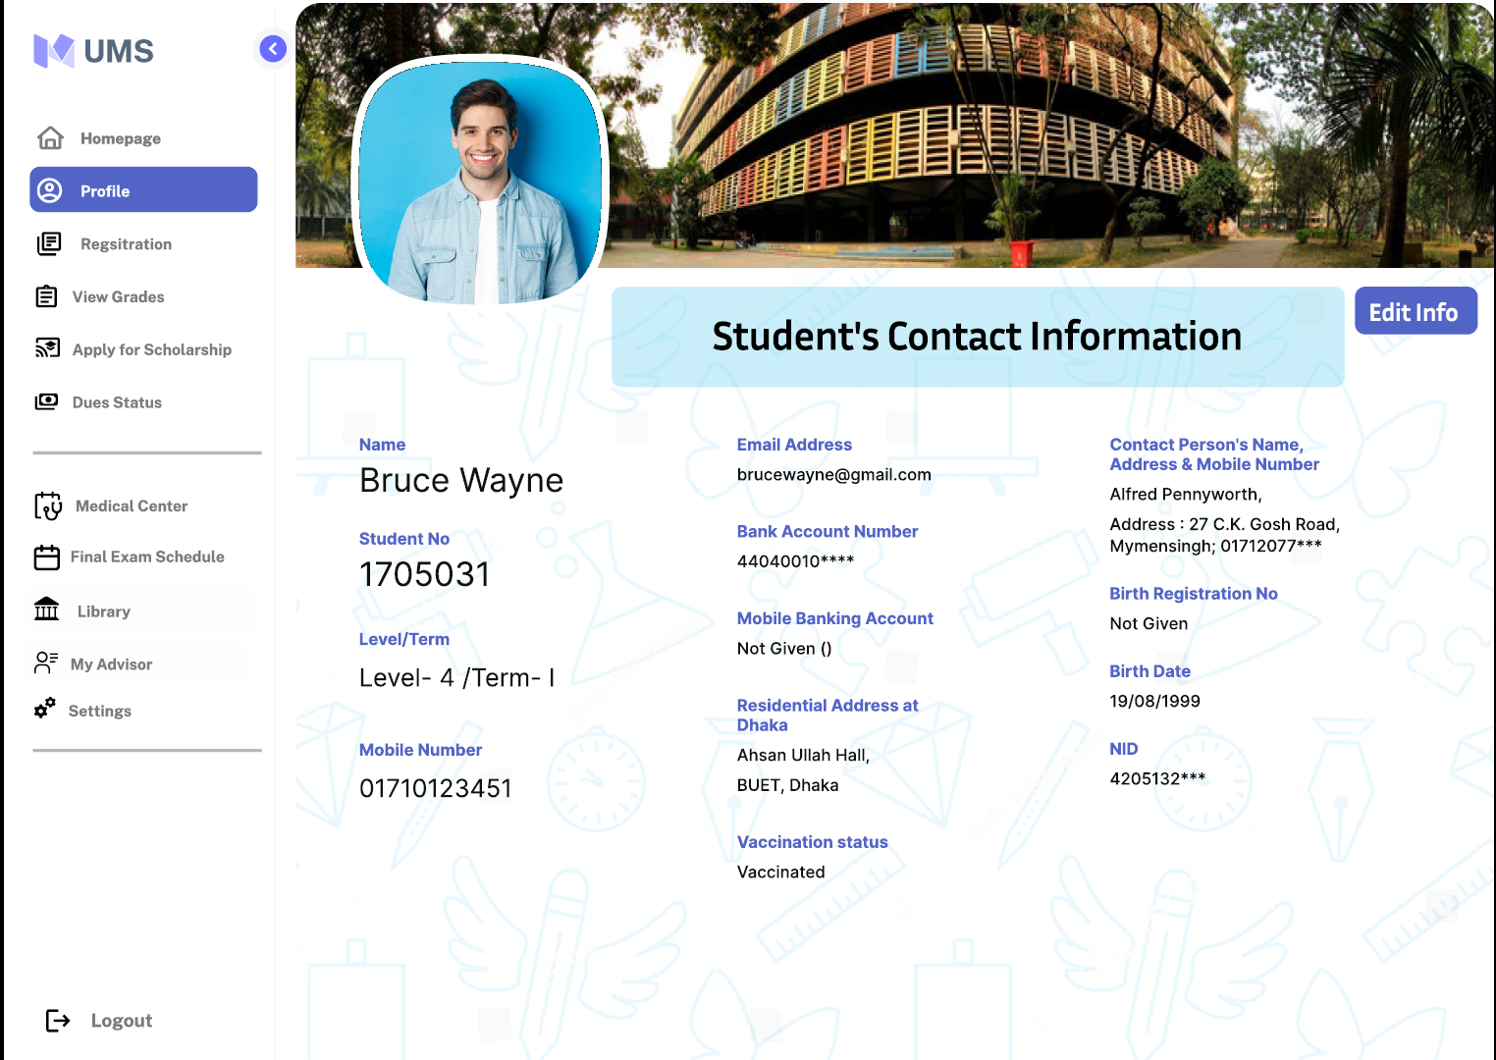
Profile info

Slide 7
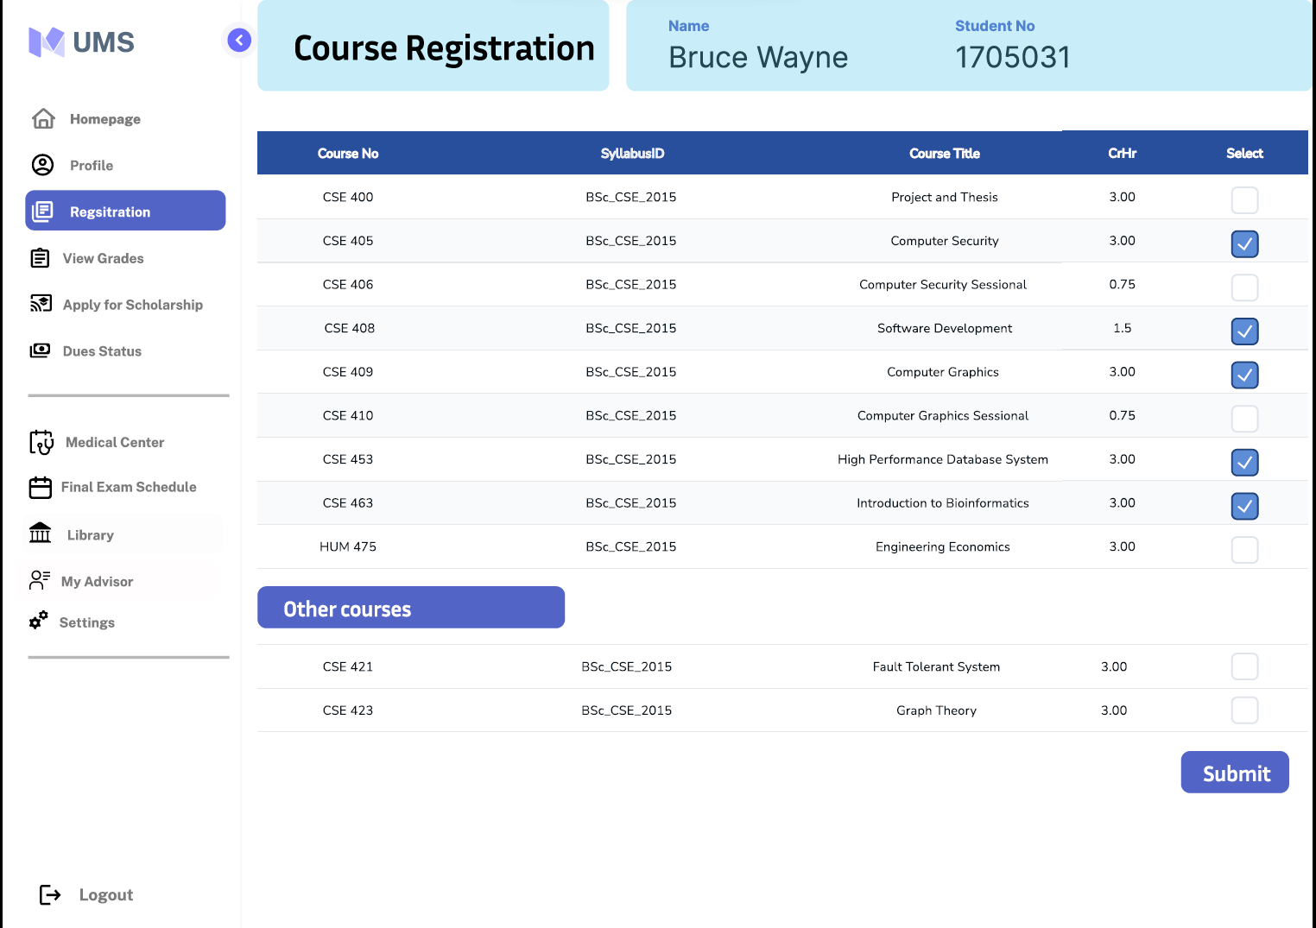
Course
Registration

Slide 8
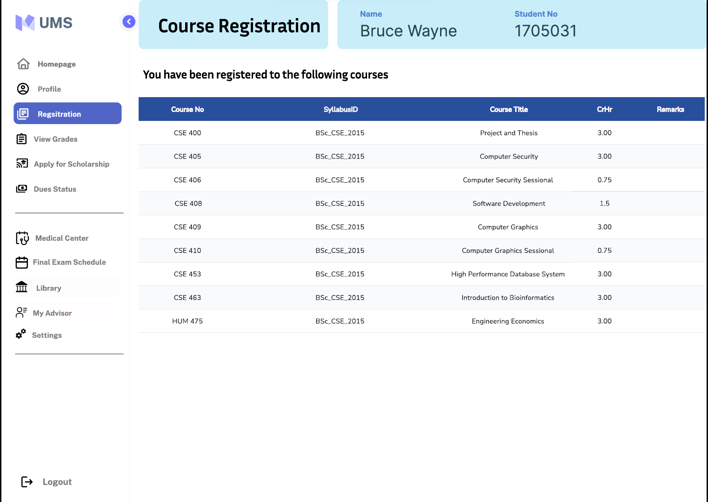
Course
Registration
Total credits: 21.00

Slide 9
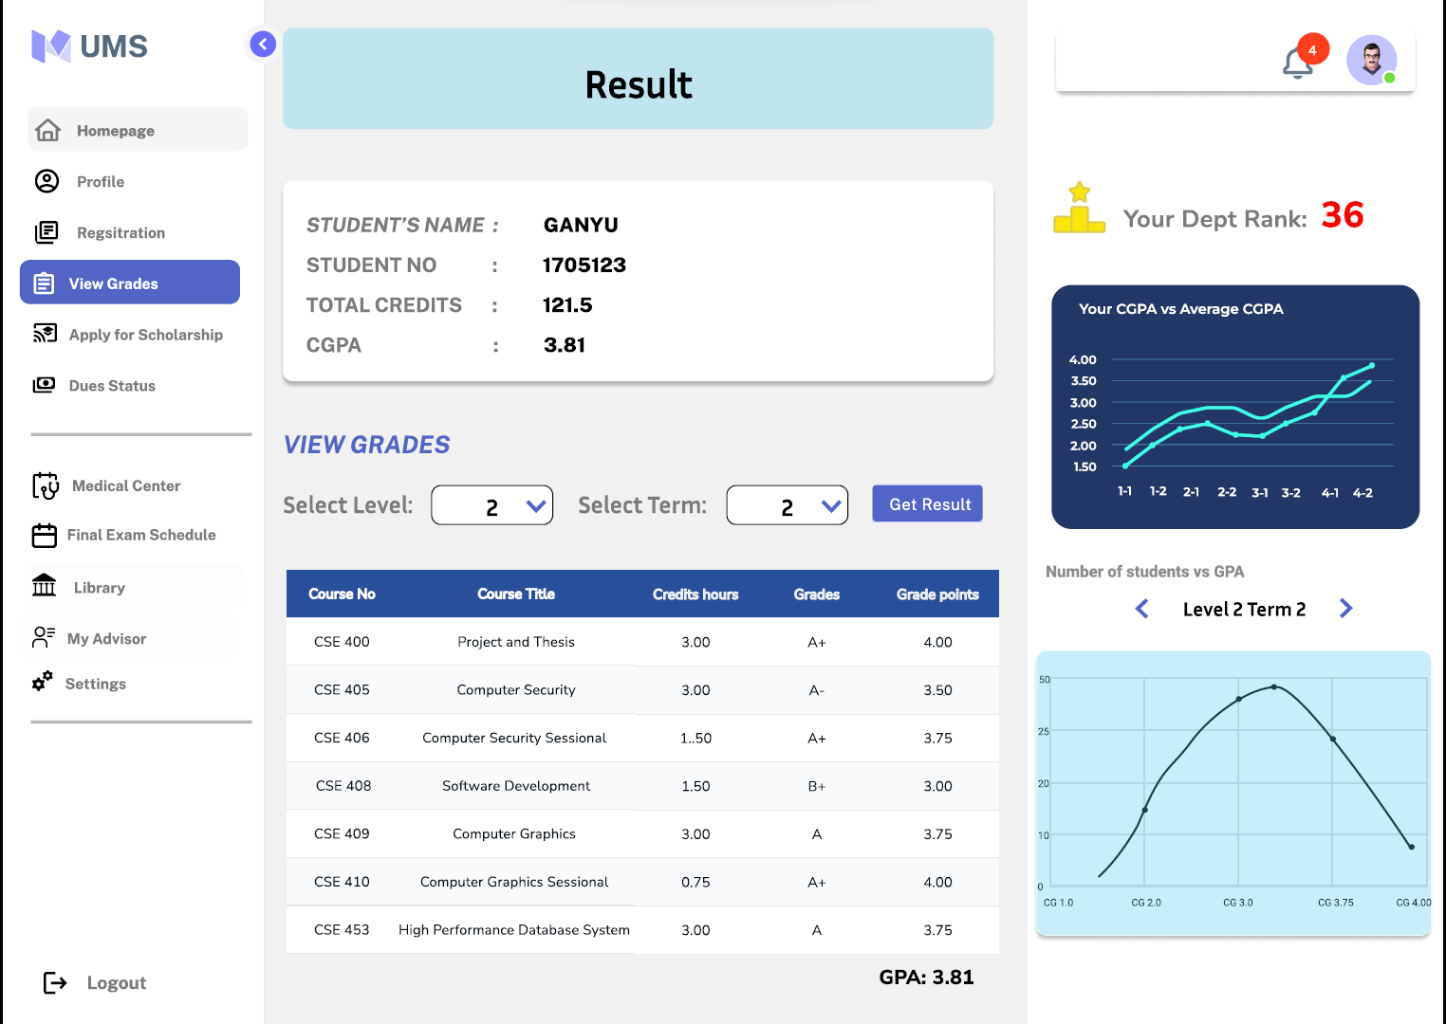
Result

Slide 10
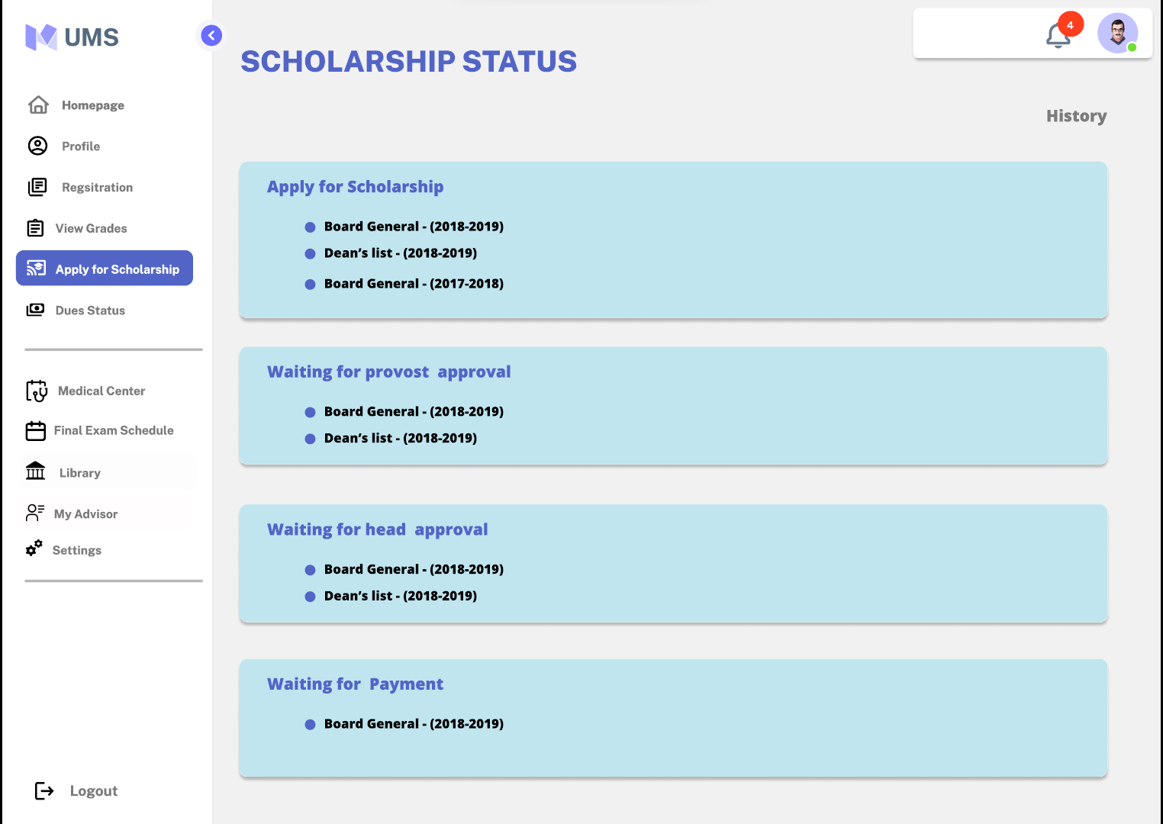
Scholarship

Slide 11
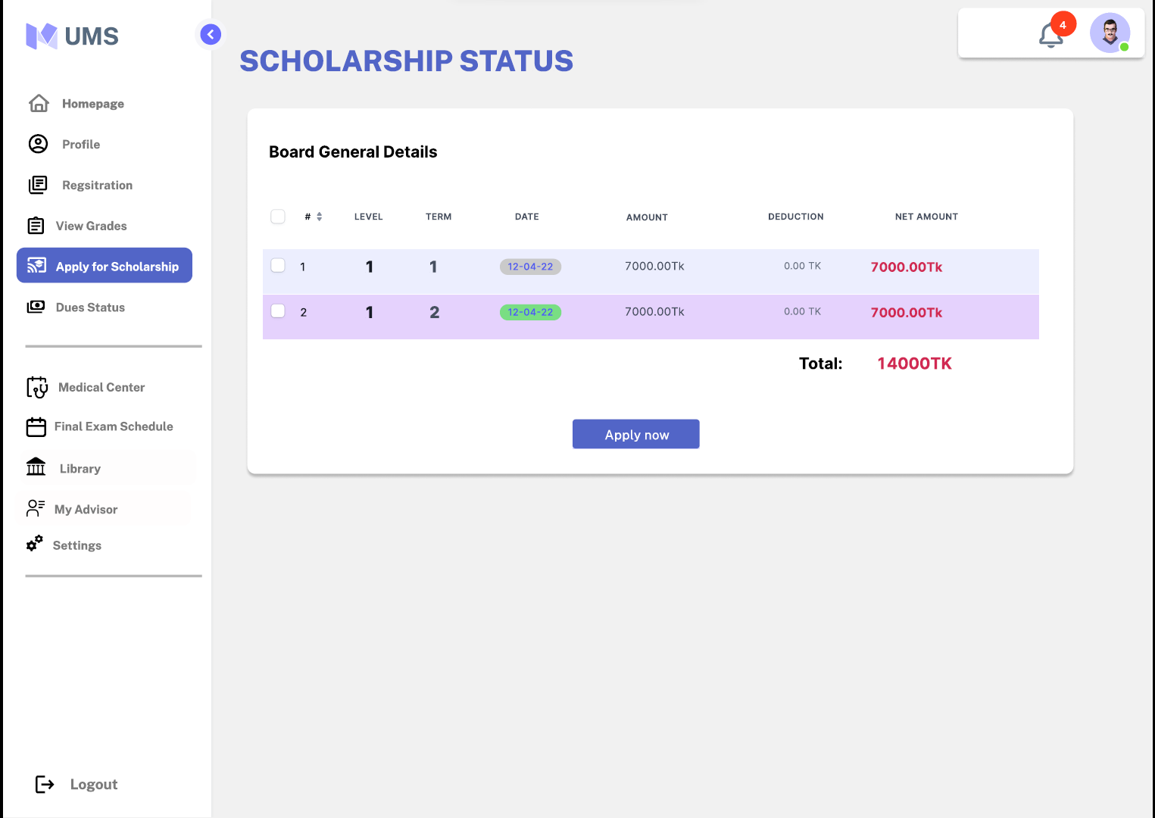
Scholarship
Details

Slide 12
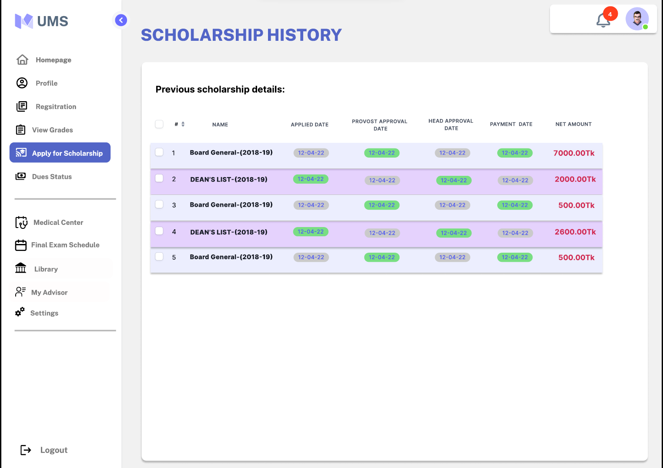
Scholership
history

Slide 13
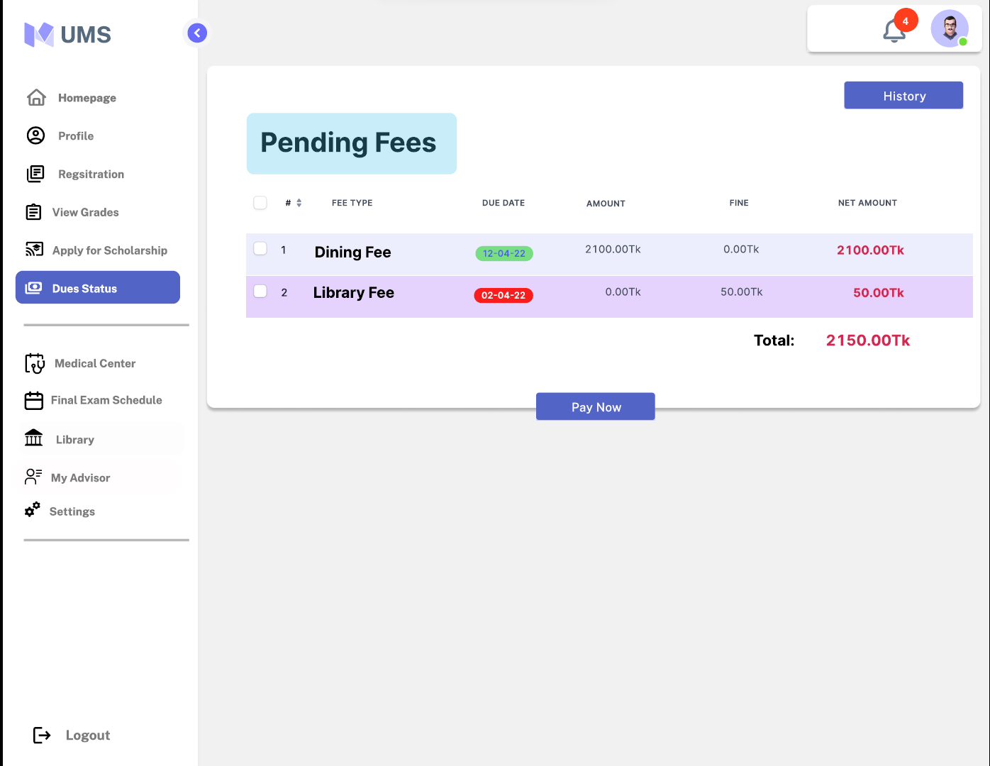
Pending fees

Slide 14
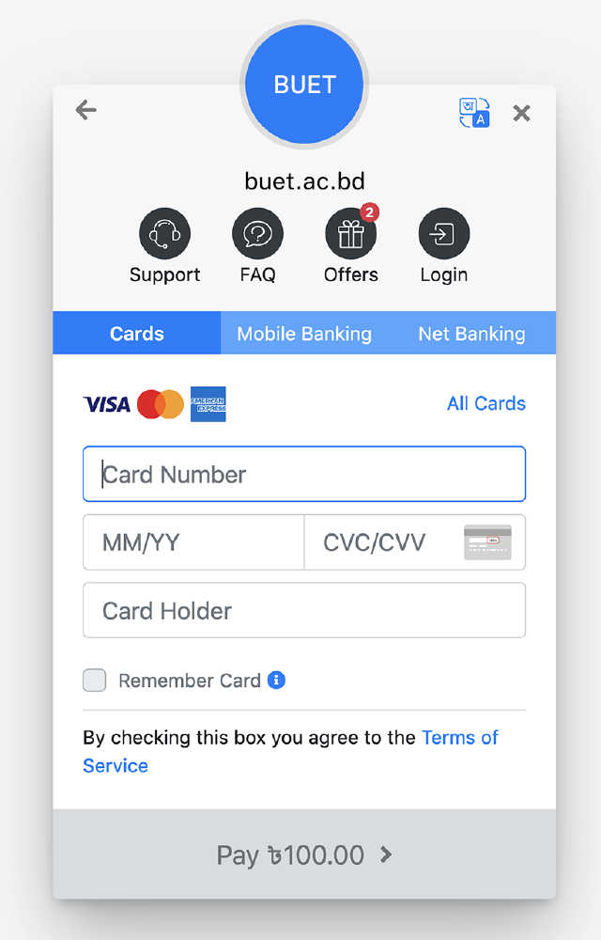
Online banking

Slide 15
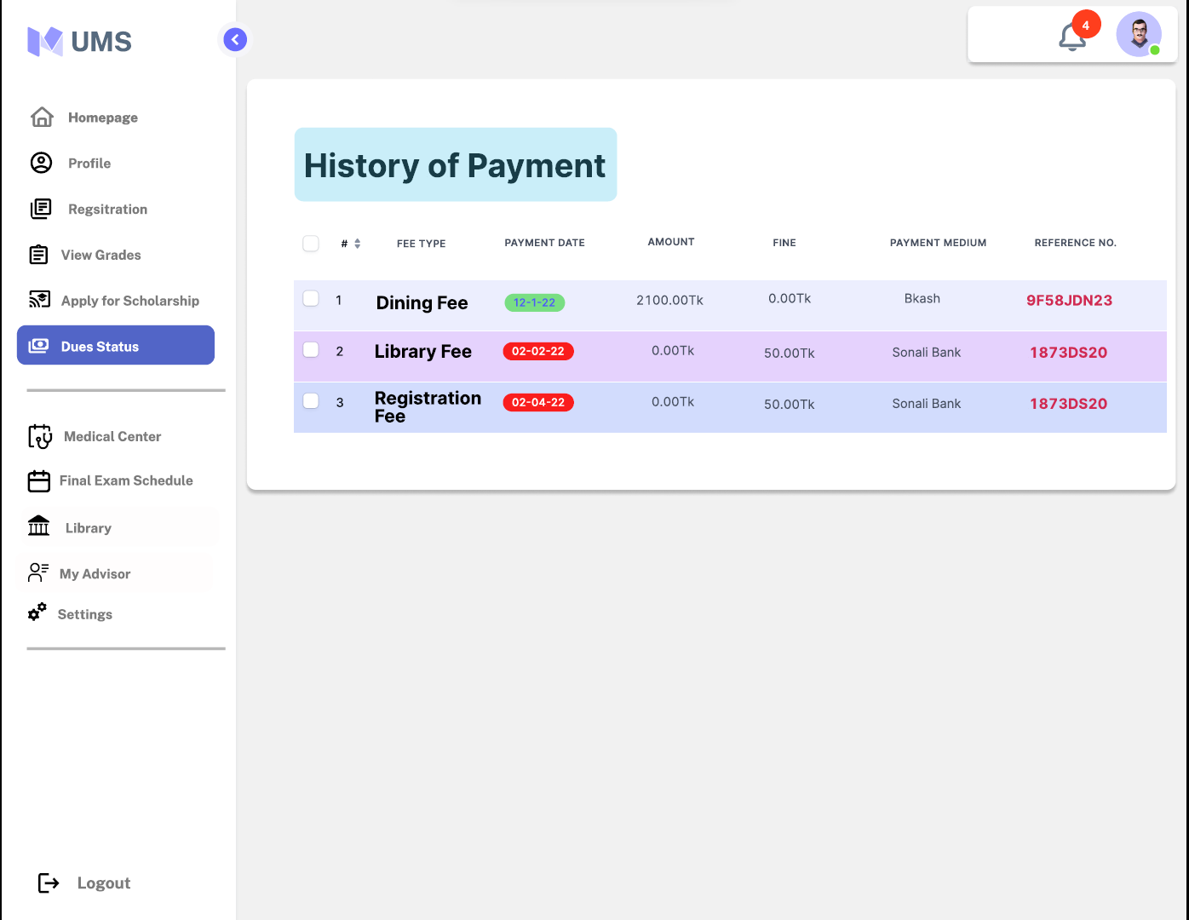
Payment
History

Slide 16
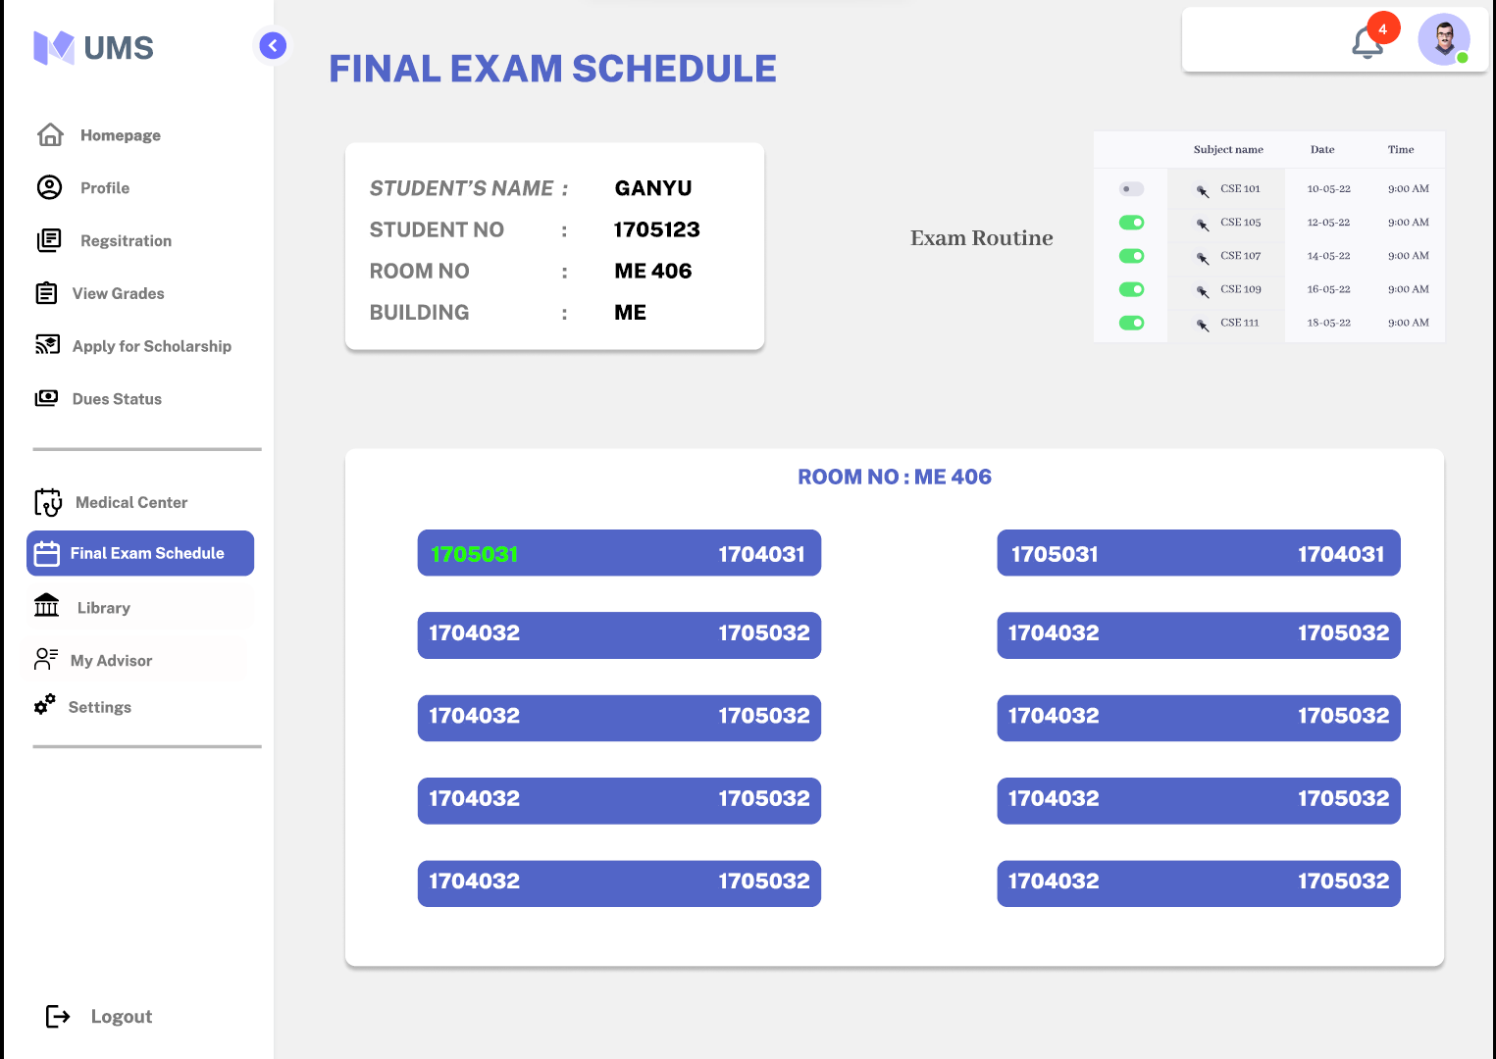
Exam schedule

Slide 17
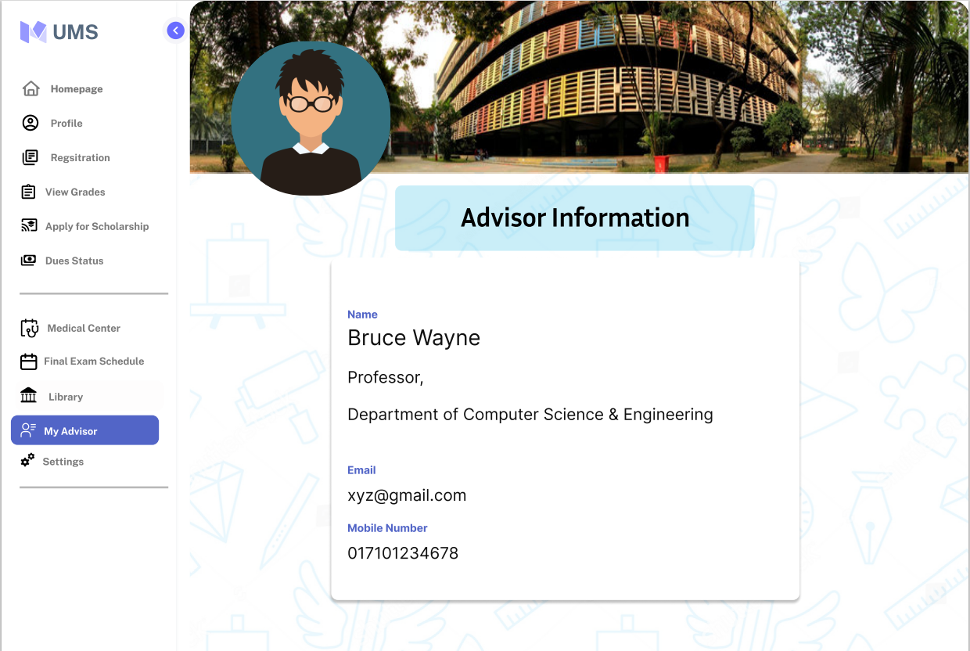
Advisor info

Slide 18
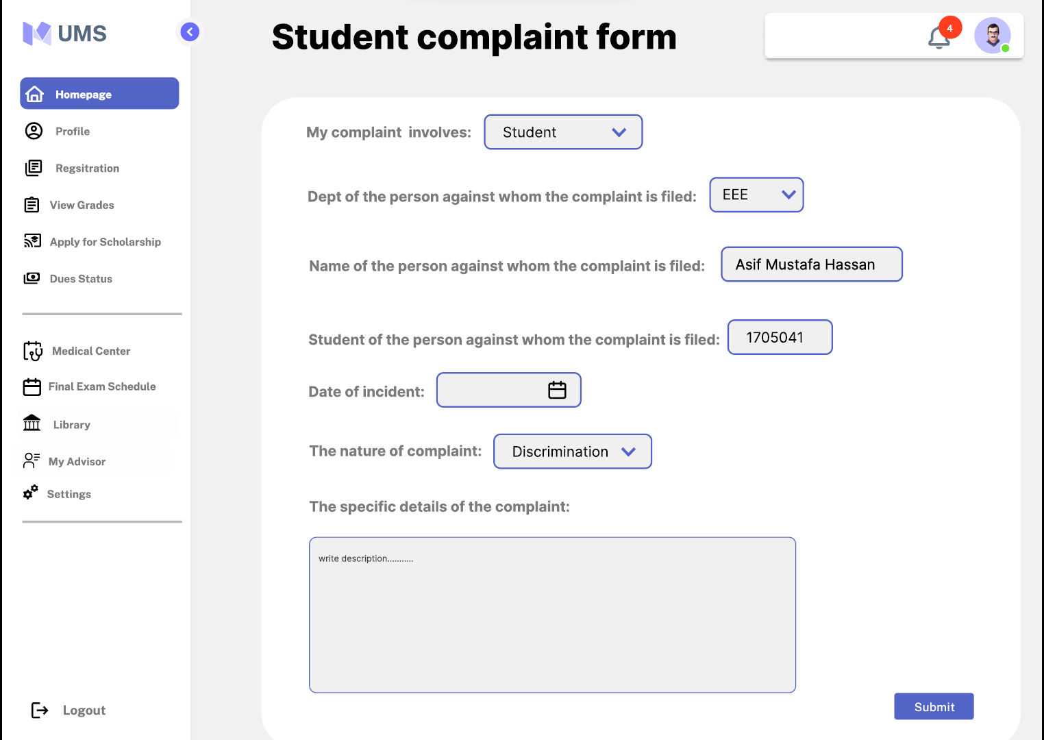
Complain/
feedback

Slide 19
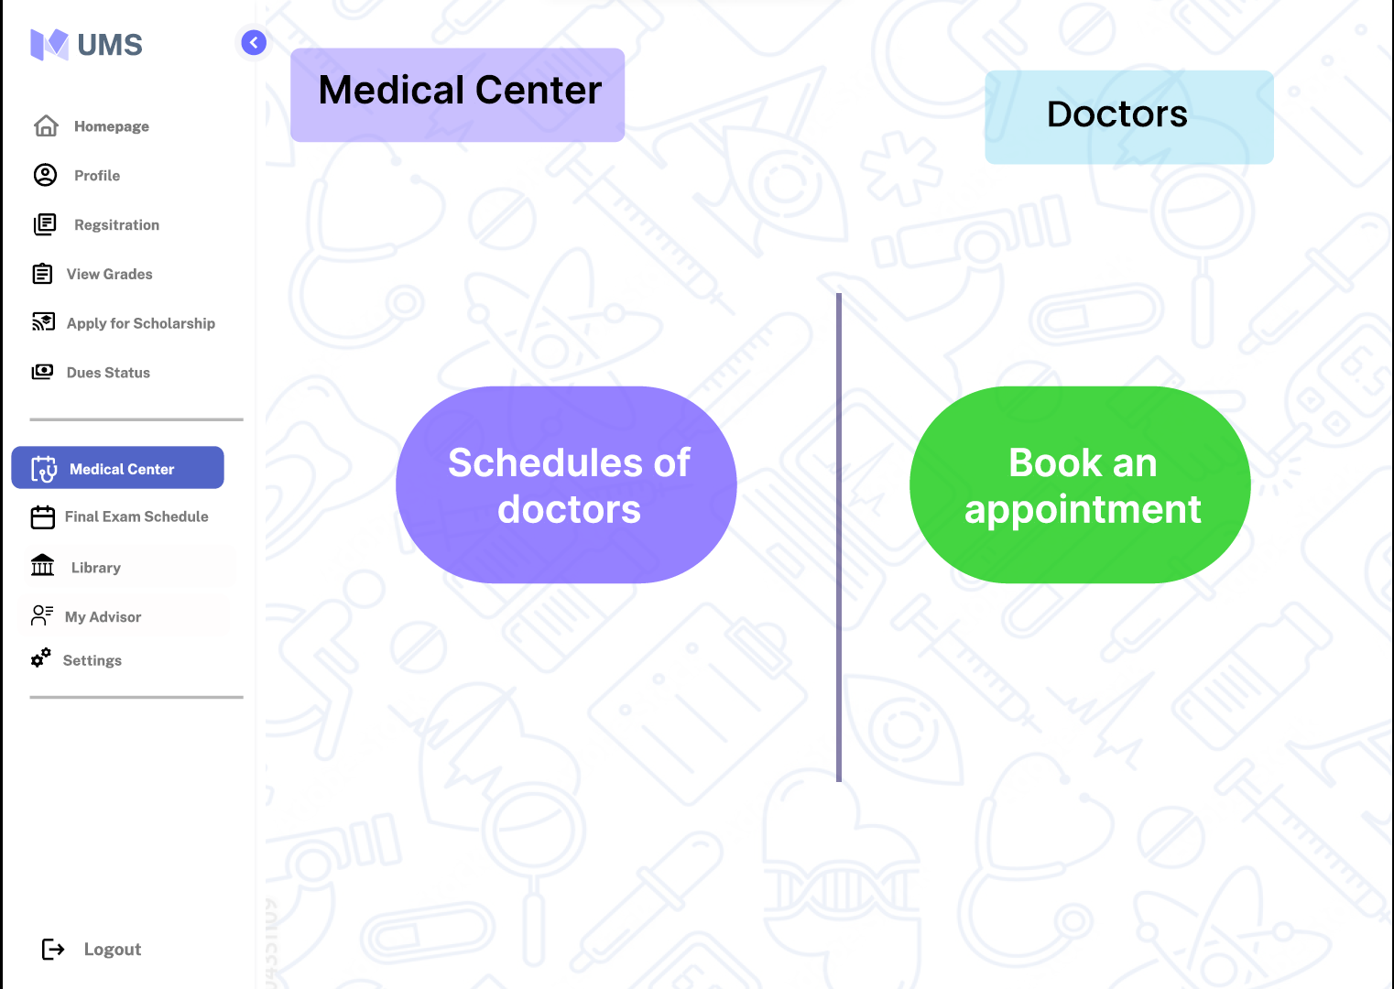
Medical
Center

Slide 20
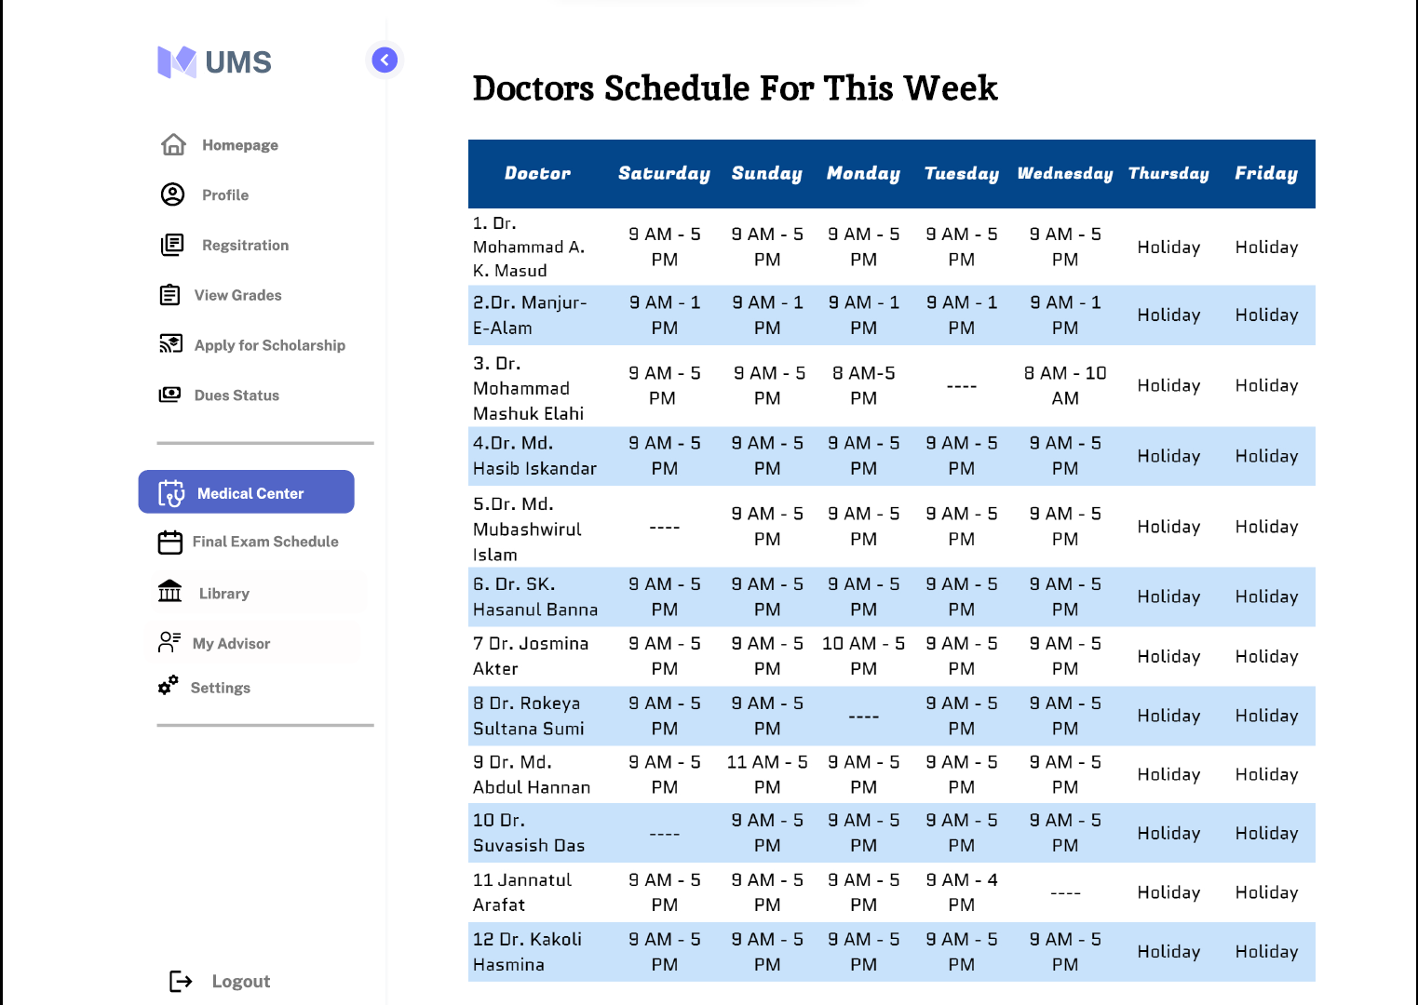
Doctor’s
Schedule

Slide 21
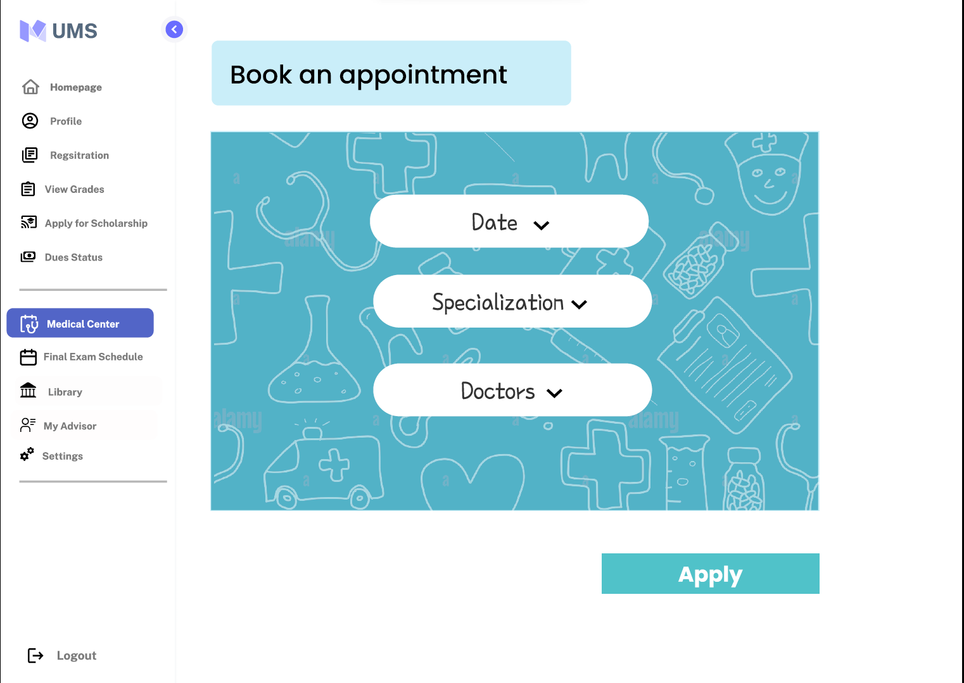
Medical
Center

Slide 22
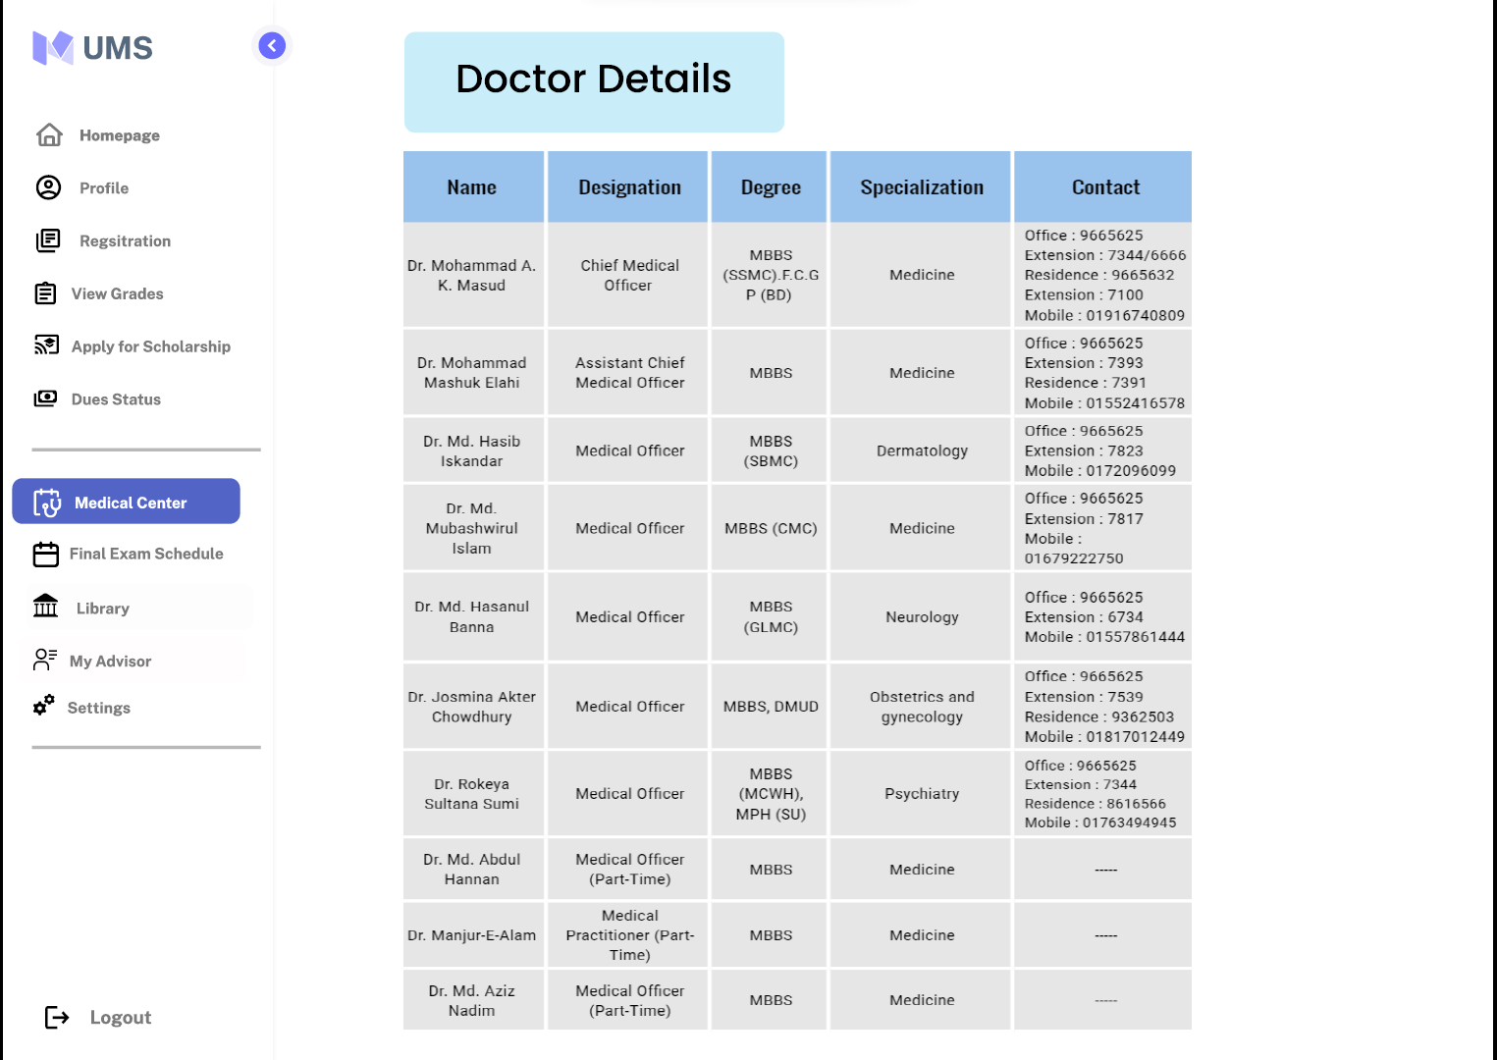
Doctor
details

Slide 23
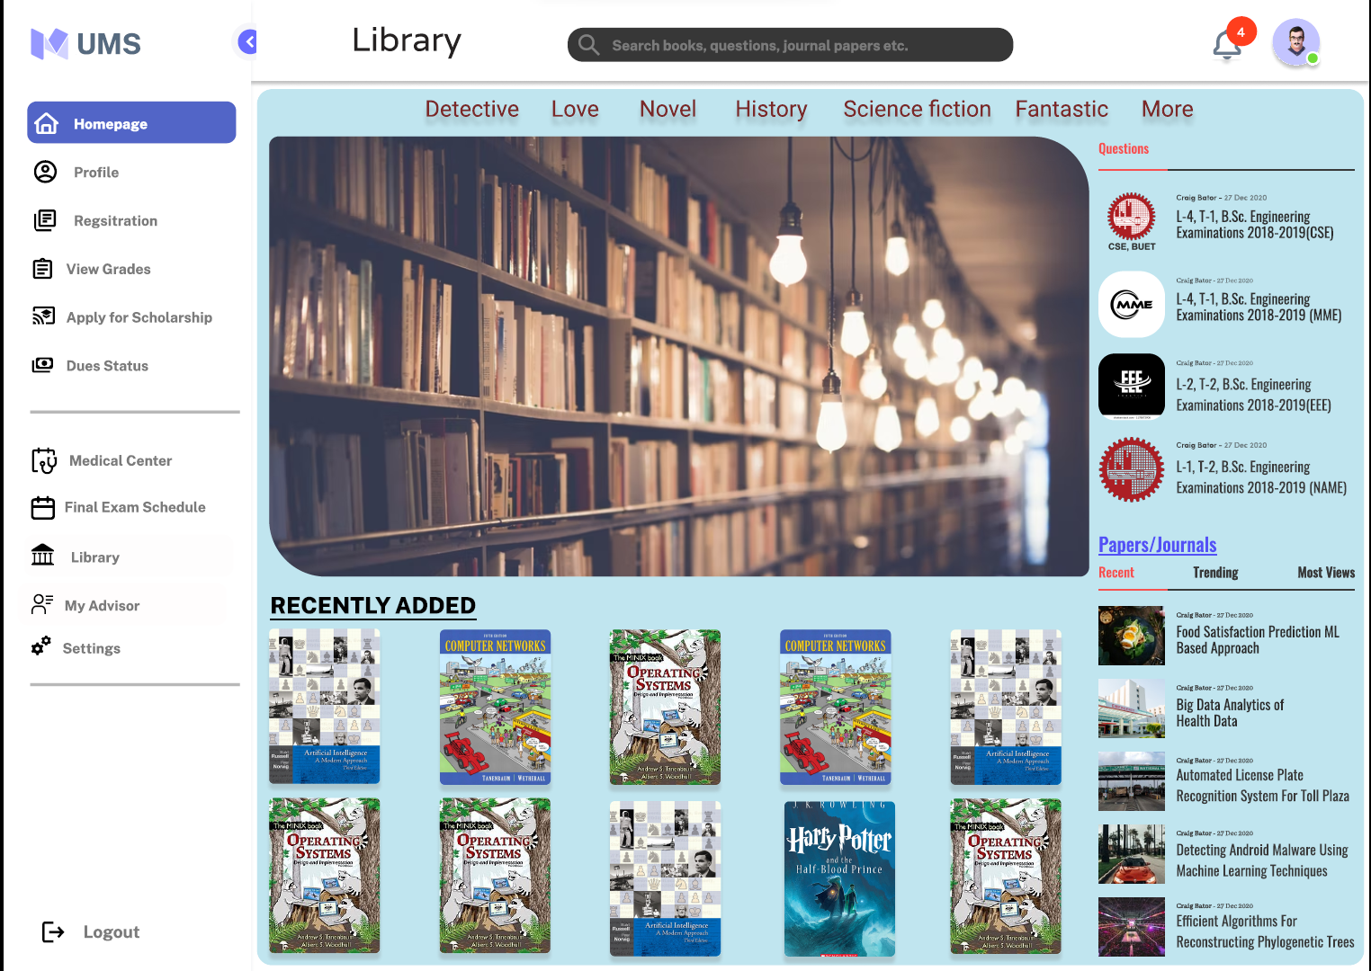
Library
homepage

Slide 24
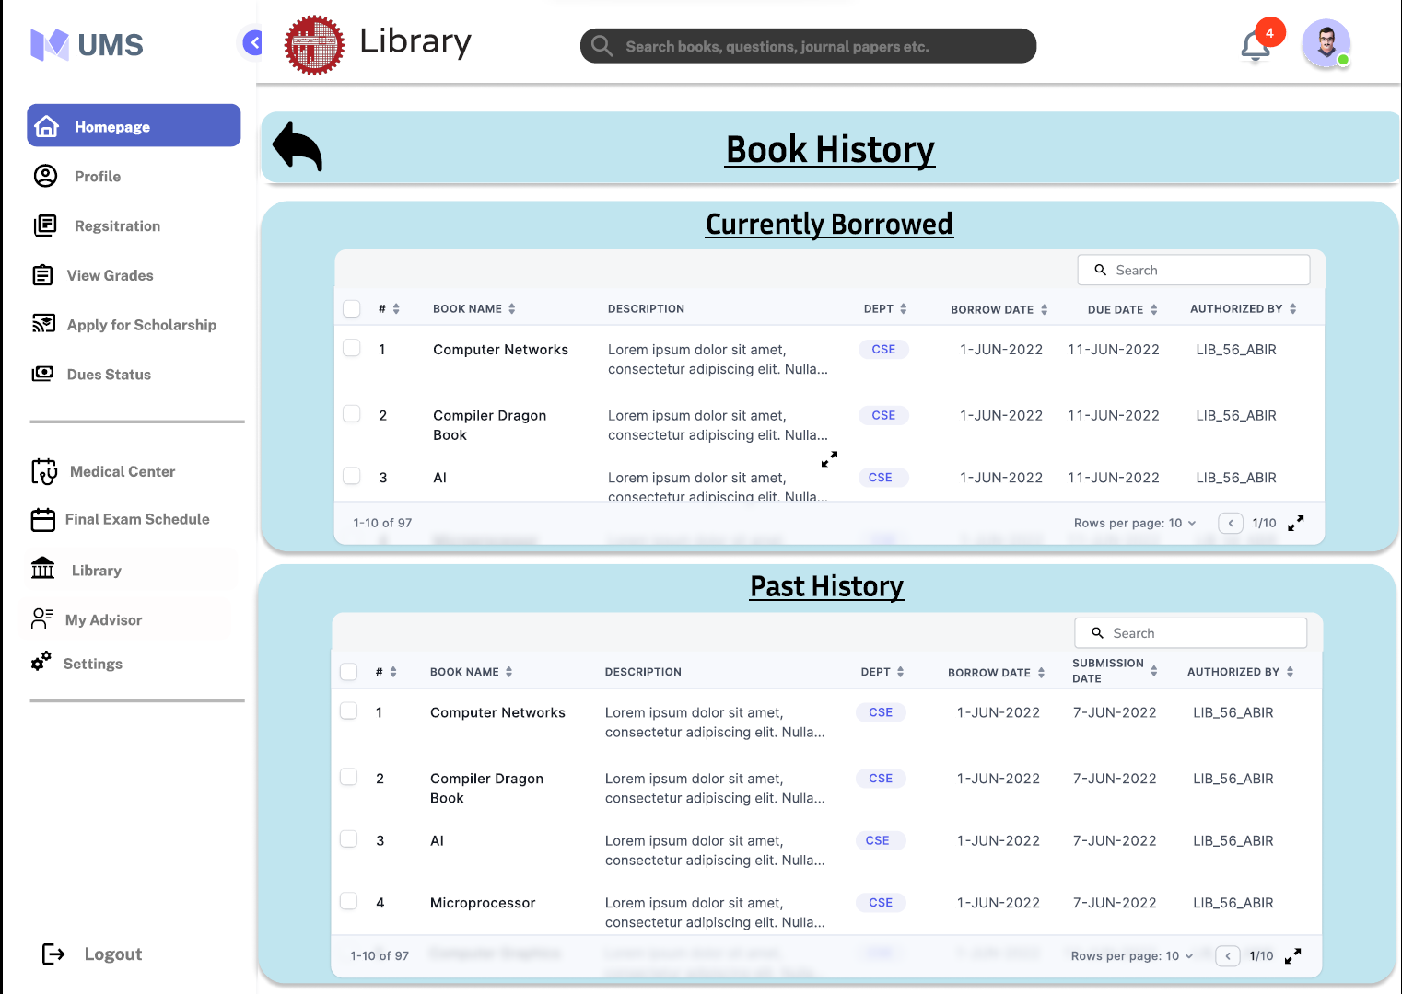
Borrowed
Book

Slide 25
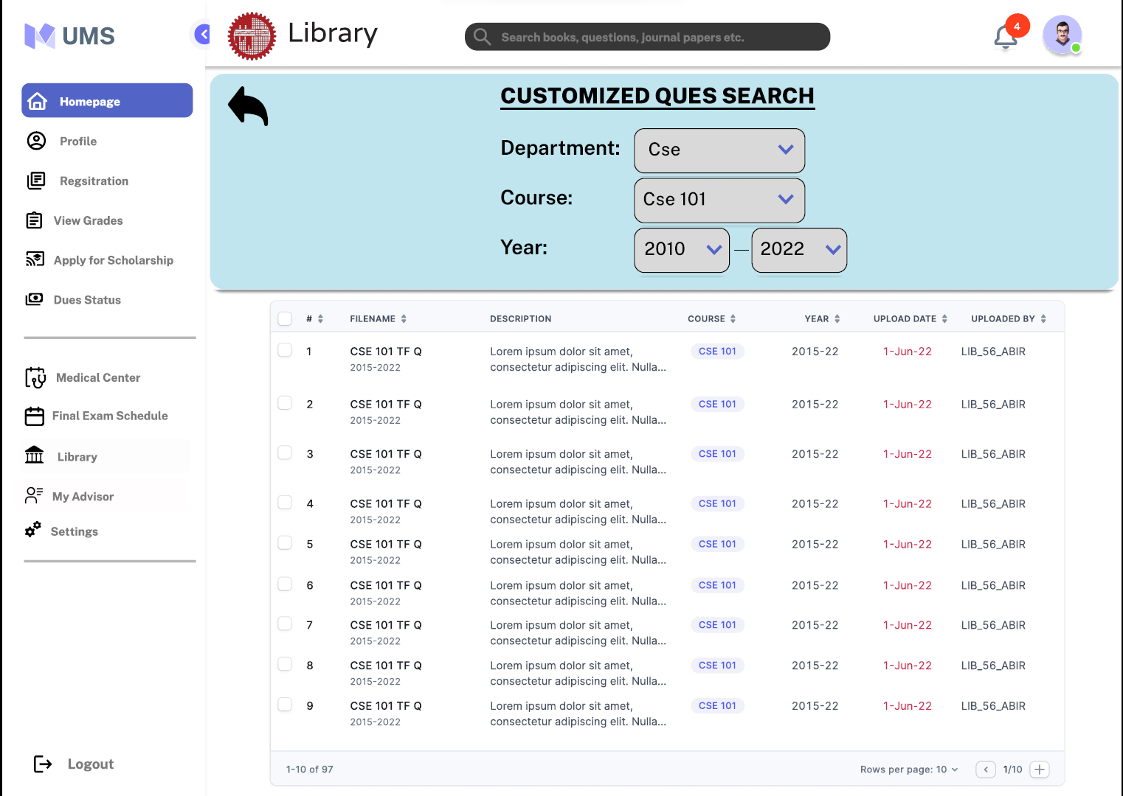
Term final
Question

Slide 26
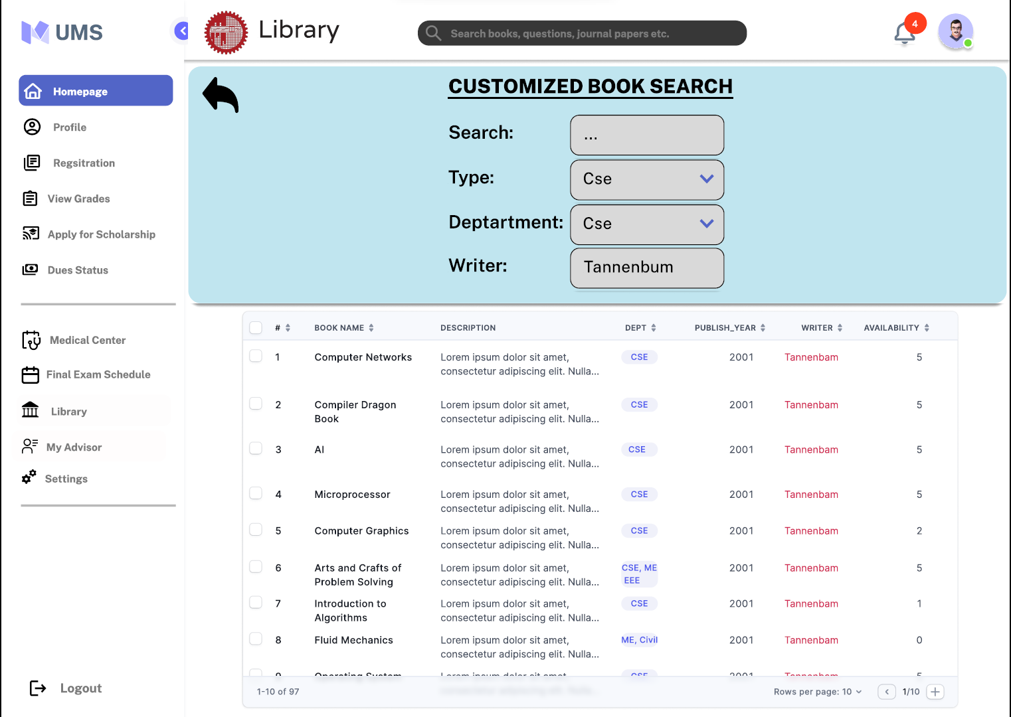
Library books

Slide 27
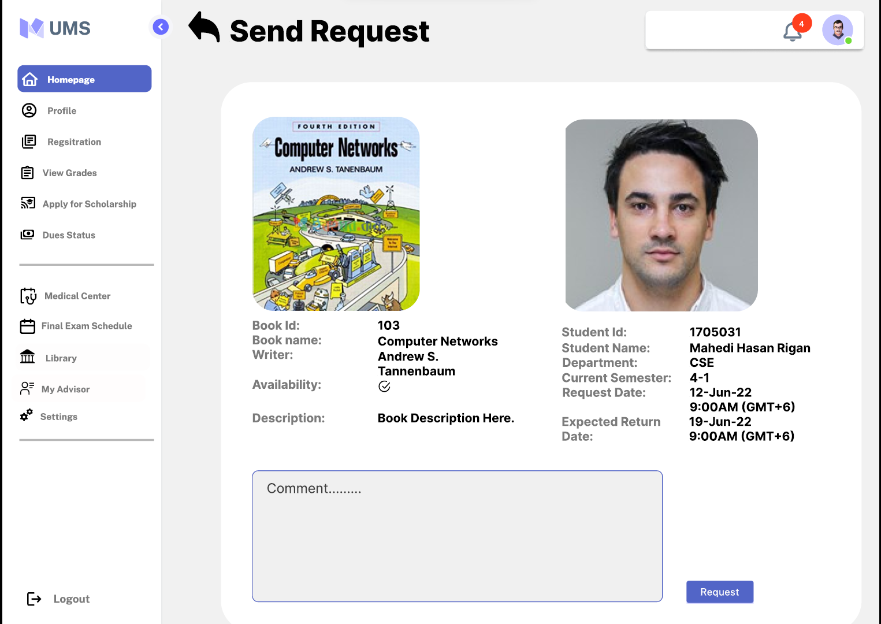

Slide 28
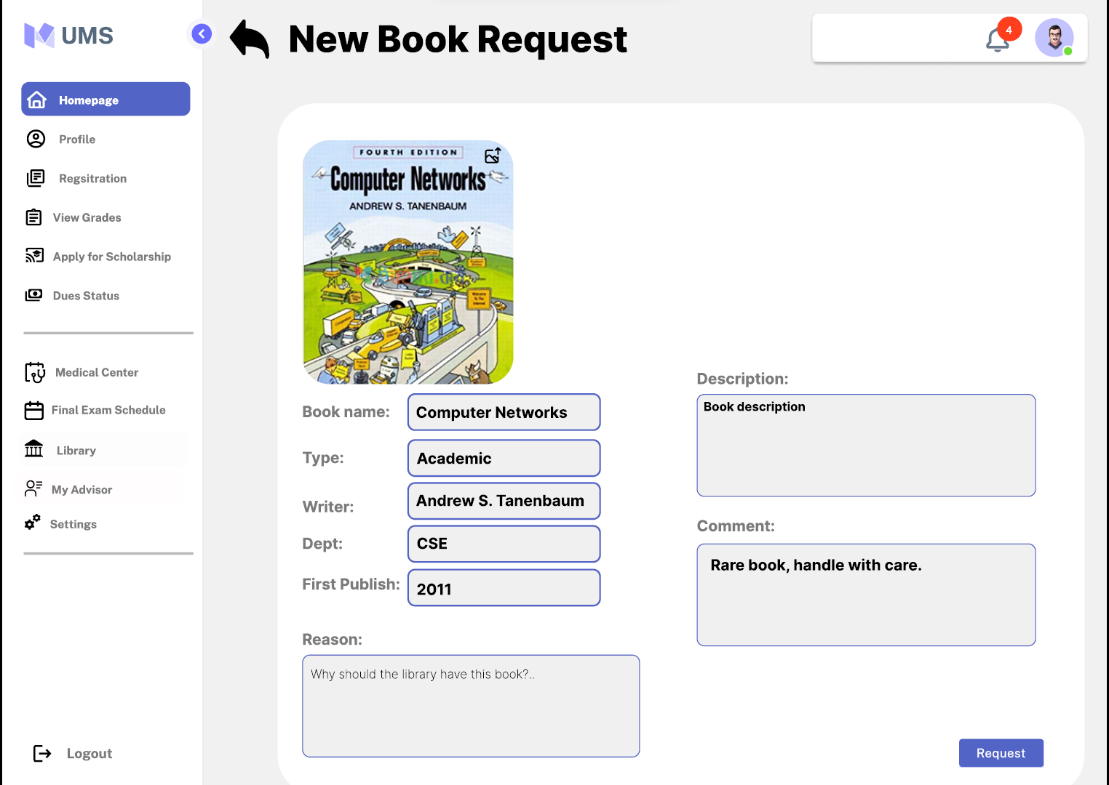
New book
Request

Slide 29

Department head Page

Slide 30
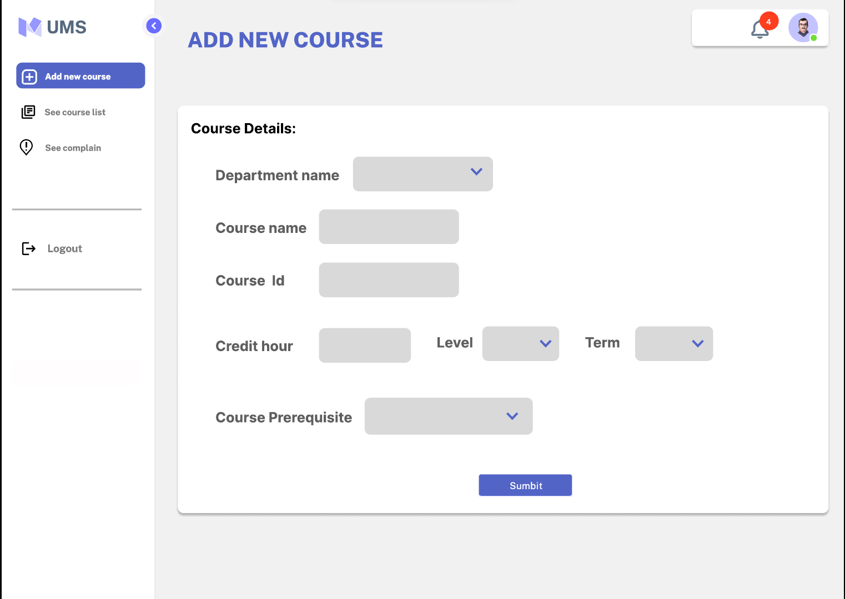
Add new
course

Slide 31
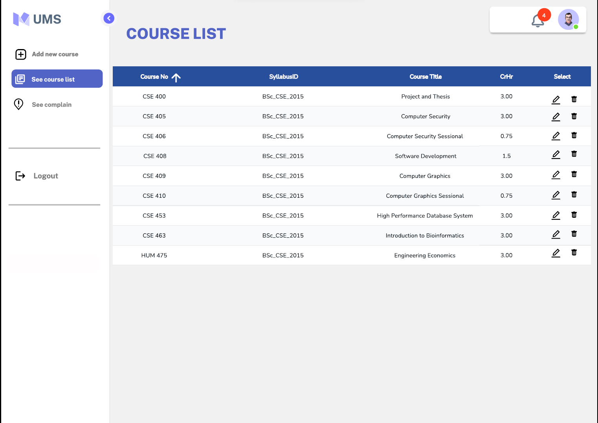
Edit/Remove
Course

Slide 32

Data entry admin Page

Slide 33
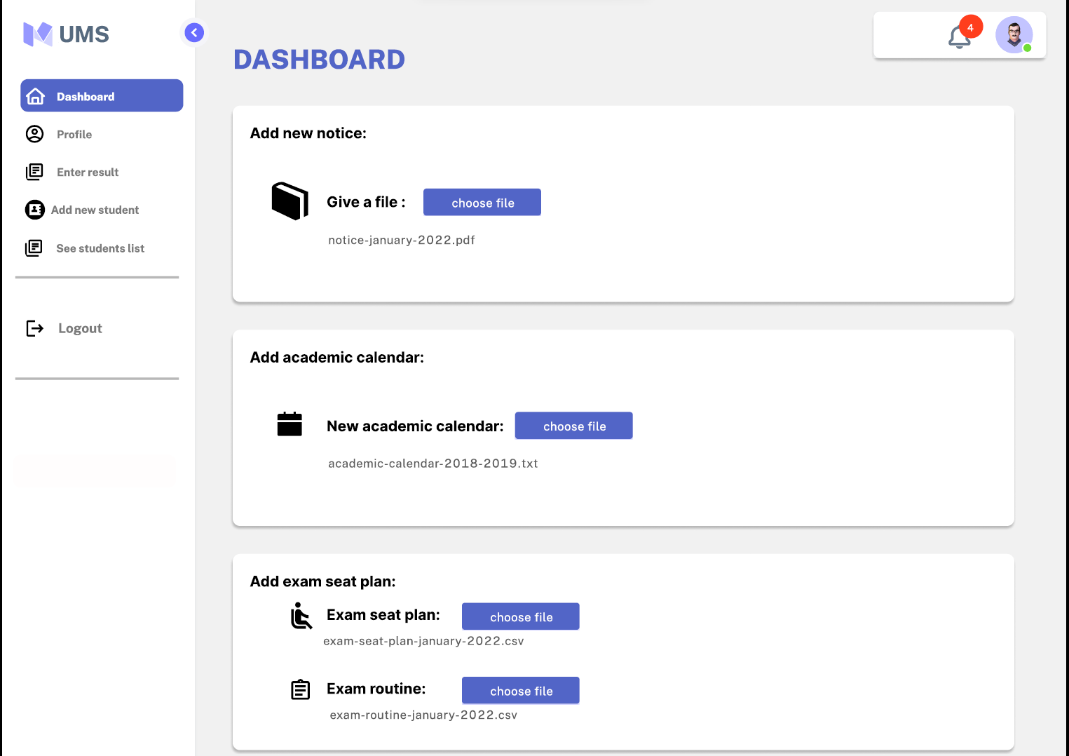
Data entry
Admin
Dashboard

Slide 34
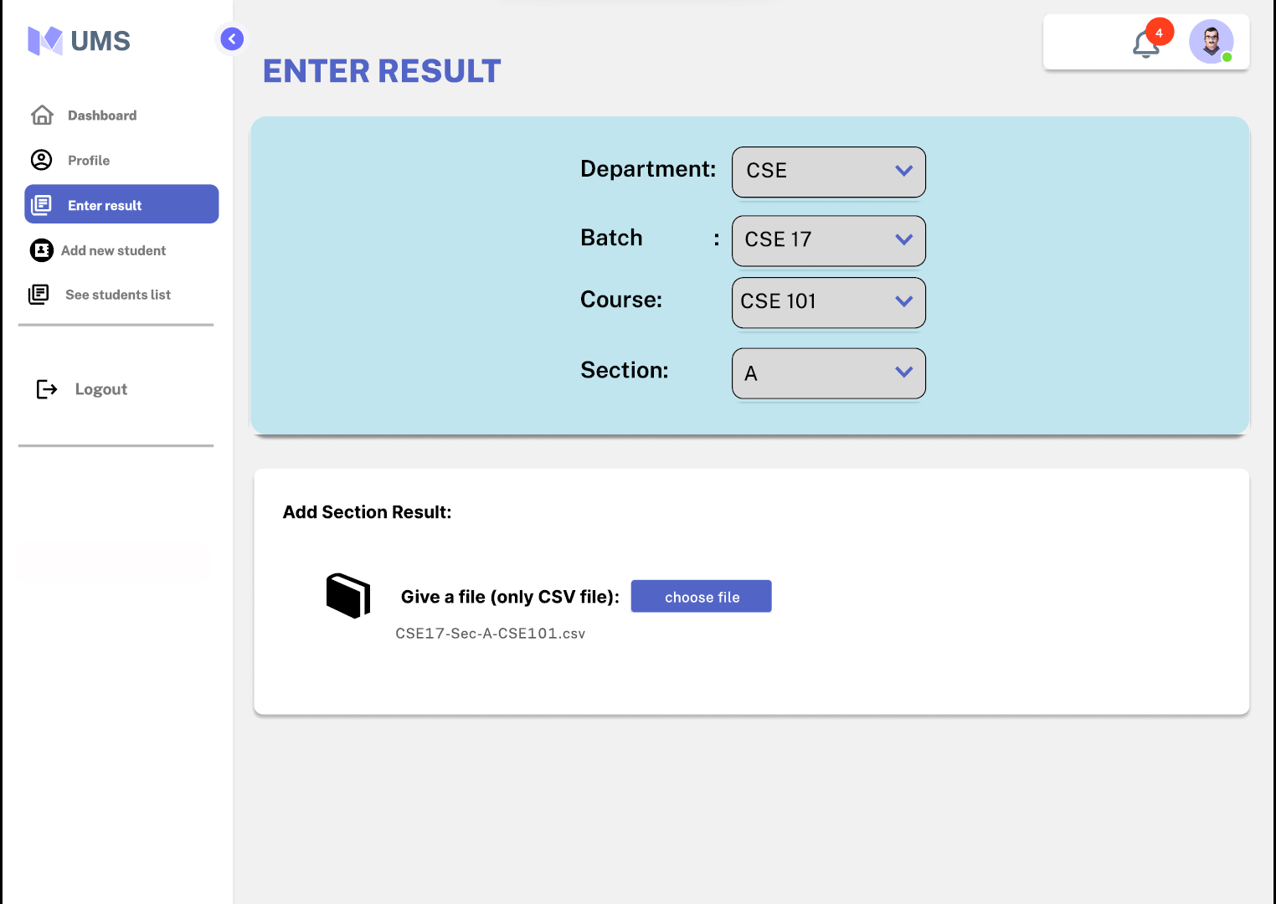
Enter Result

Slide 35
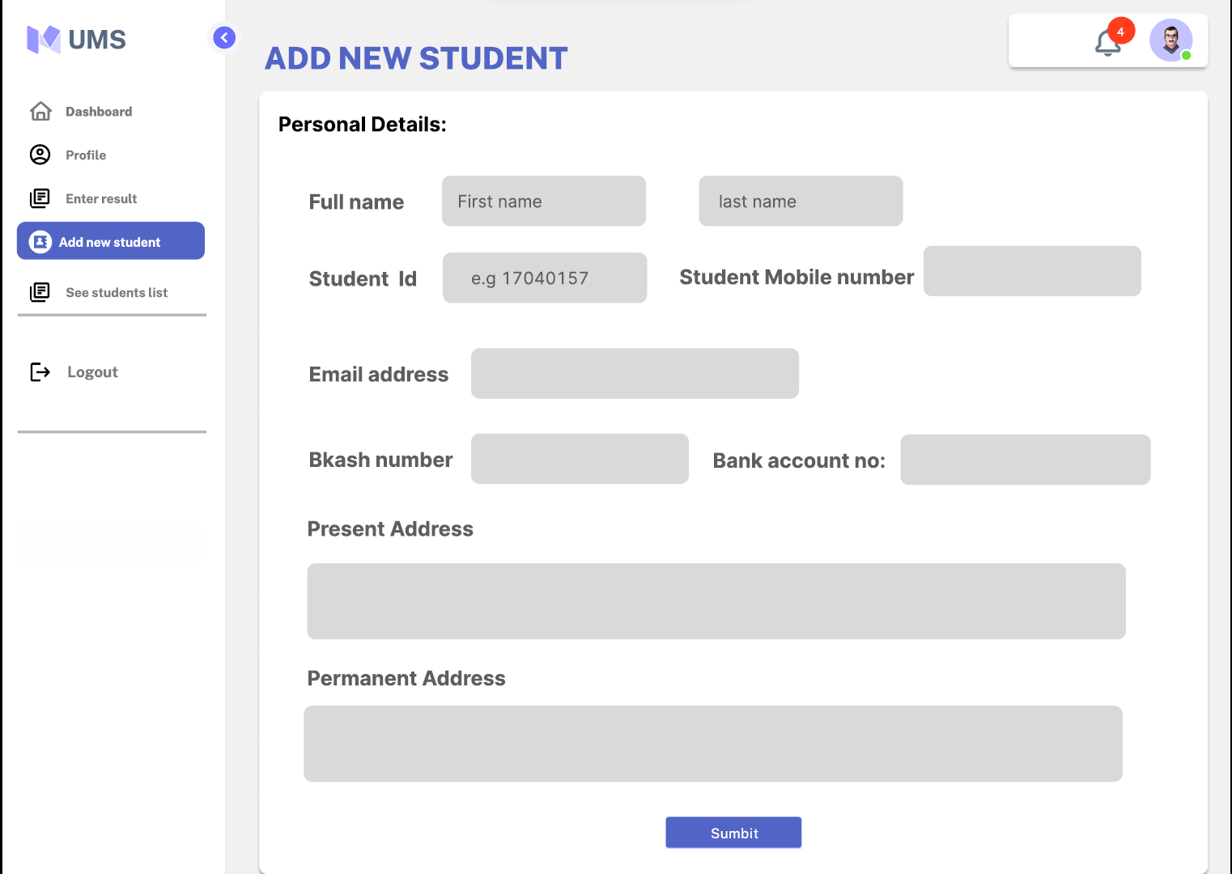
Add new
student

Slide 36

Librarian

Slide 37
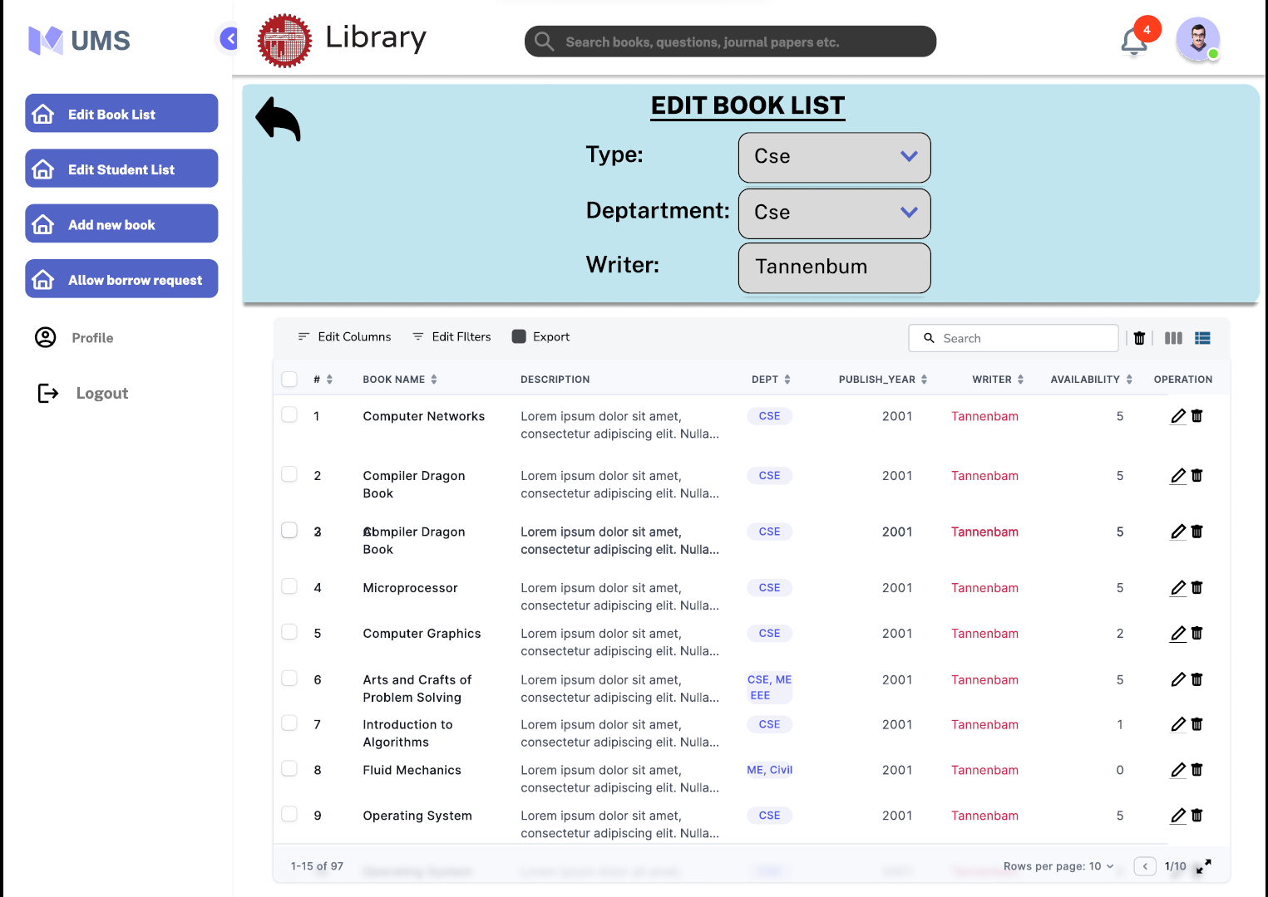
Edit Book
List

Slide 38
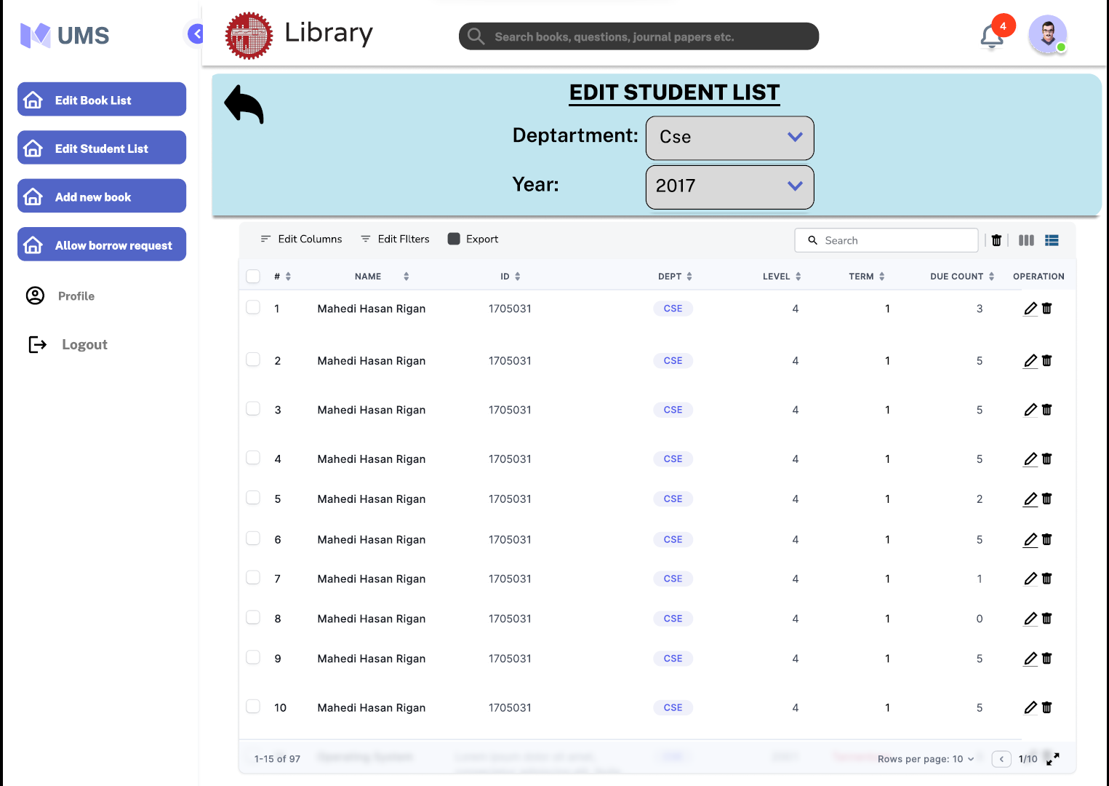
Edit Student
List

Slide 39
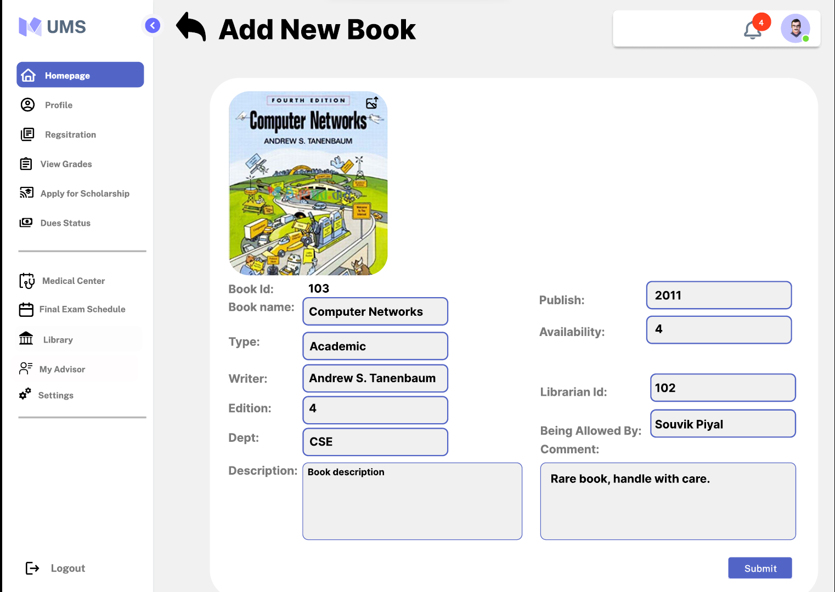
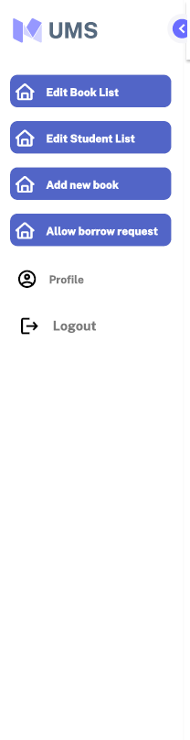
Add new
book

Slide 40
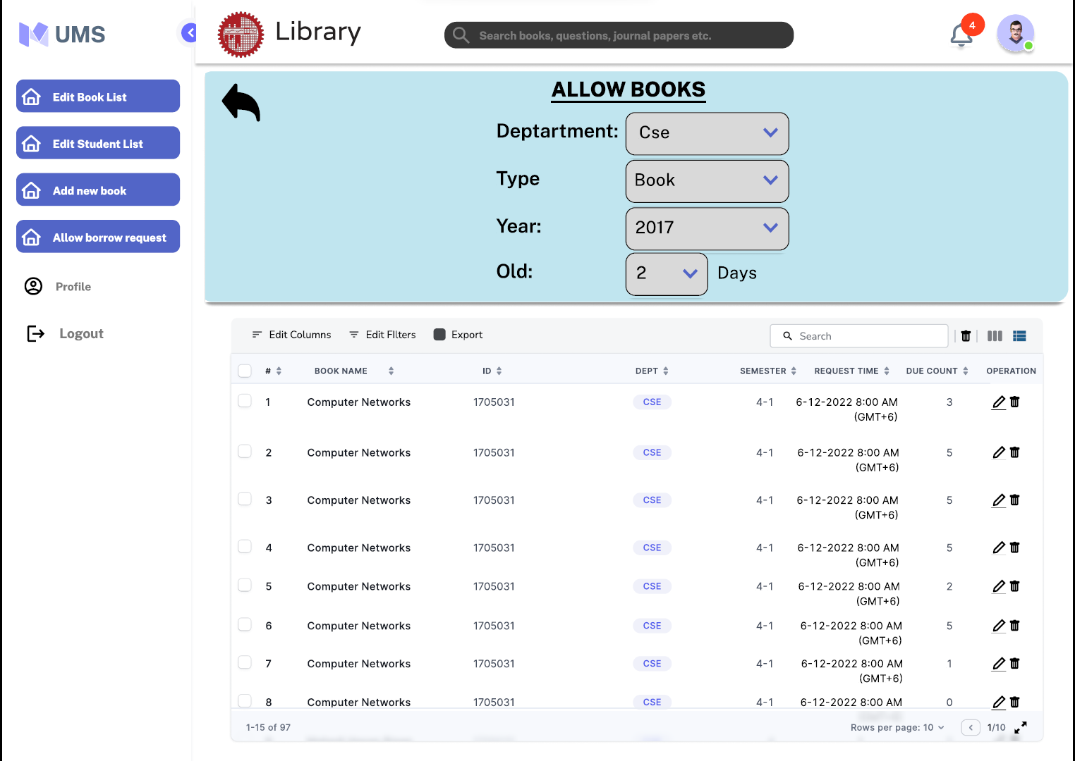
Allow books

Slide 41
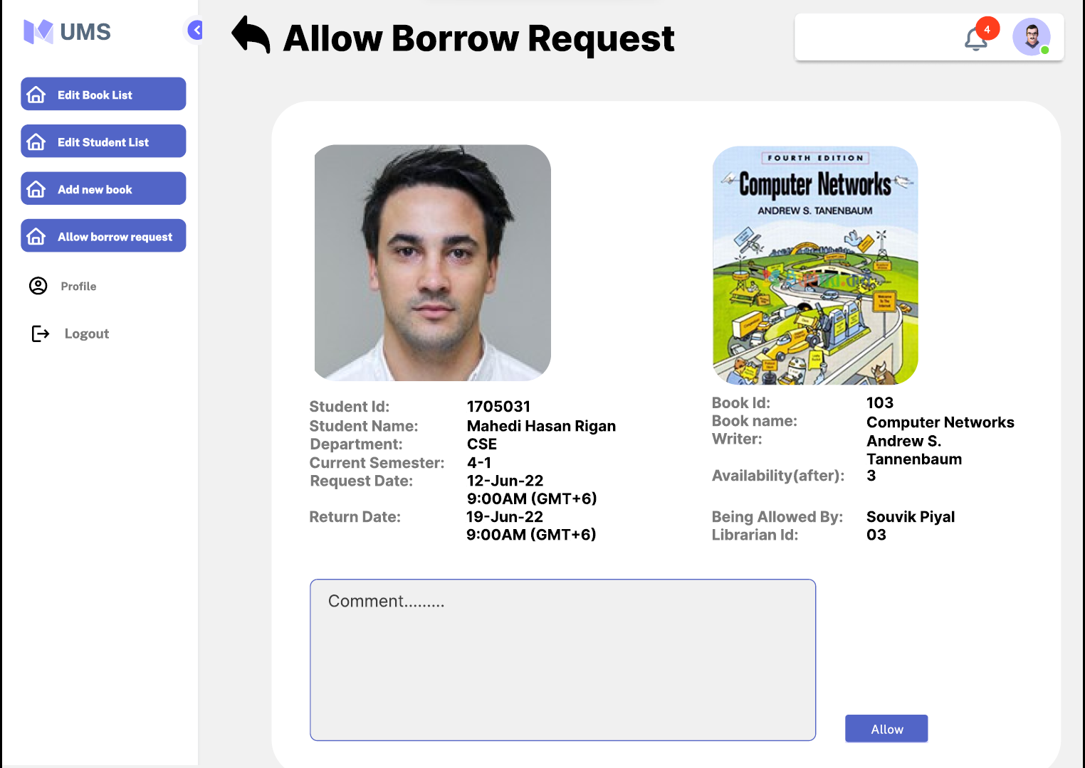
Allow borrow
Requests

Slide 42
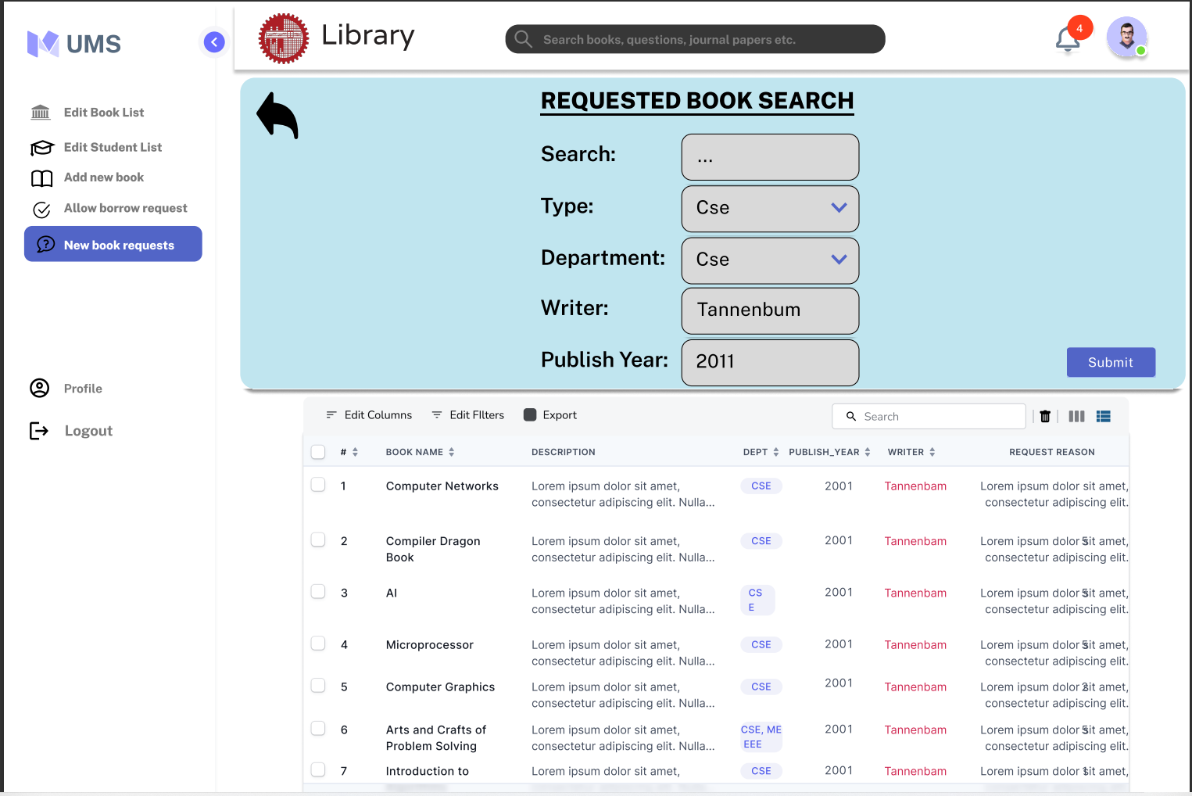
Requested Books Search

Slide 43

Doctor manager

Slide 44
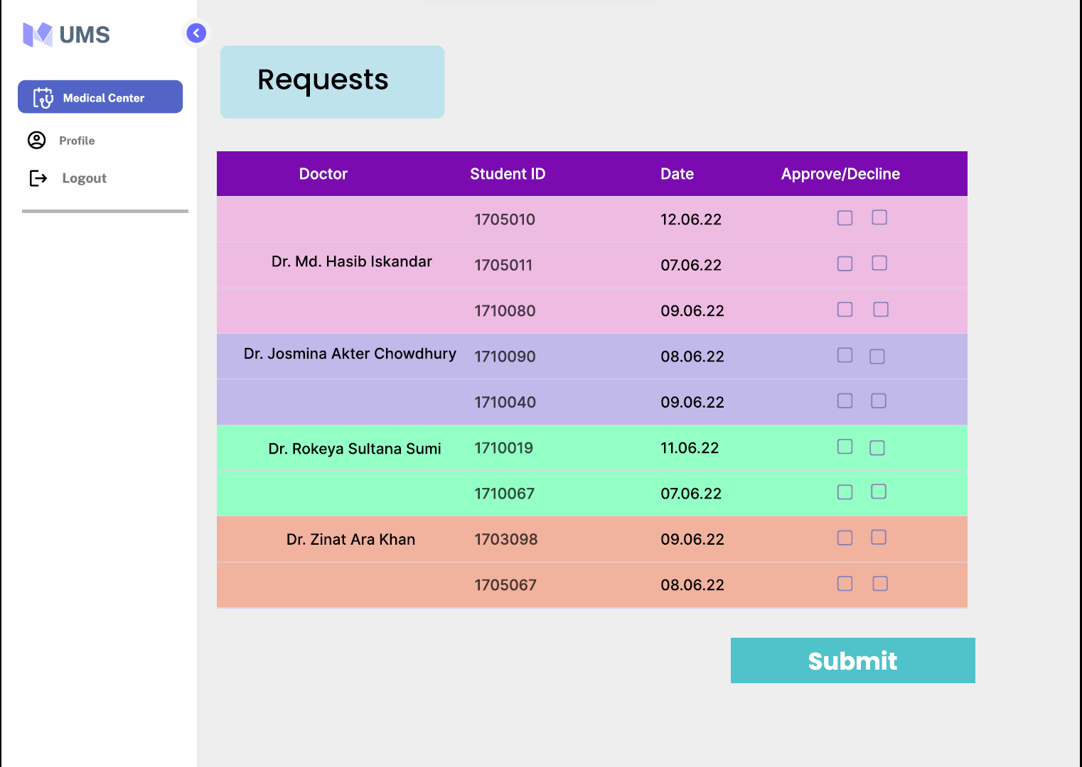
Medical
Staff

Slide 45
THANK YOU

